Slide 1

CSCI 5308
Advanced Topics in Software Development
WATCH2GETHER
Team Number: 11
B00899473 - Hemanth Nadipineni
B00899481 - Subash Narayanan
B00903585 - Sangramsinh More​
B00911296 - Nishit Mistry​
B00913134 - Trushita Maurya
Professor: Tushar Sharma​
TA: Manjinder Singh
Client Team Number: 21

Slide 2
SUMMARY
Better decision-making in choosing a new show or movie by utilizing Ratings Visualizer and Scheduler to plan and schedule watching.
Help people get a platform to discuss their favorite movies or shows by creating Discussion Threads.
Build your online community by creating WatchGroups and discussing theories by creating posts and commenting on a particular post.
Find an existing WatchGroup for movies or TV shows you like and join groups.

Slide 3
INDIVIDUAL TASK STATS
TOTAL NUMBER OF TASKS | 100
NAME | TASKS COMPLETED | STORY POINTS
TRUSHITA | 20 | 107
NISHIT | 20 | 112
SANGRAMSINH | 20 | 102
SUBASH | 20 | 105
HEMANTH | 20 | 110

Slide 4
INDIVIDUAL TASK STATS
TRUSHITA MAURYA
FEATURES WORKED ON
Movie Rating Calculation
TV Show Rating Calculation
Chart Plotting by generating data for X - axis and Y - axis
TV Show Rating - Season Wise Ratings
Chart Styling to Match application
View the Ratings of any TV show or movie selected by user on home page
Legends and X - axis and Y - axis labels for chart readability
Hovering data points to display the data label for the ratings
Fetching data from TMDB API to receive user ratings on TV shows / movies
Edit Comment option
Store and Fetch Comments - backend

Slide 5
INDIVIDUAL TASK STATS
NISHIT MISTRY
FEATURES WORKED ON
User Profile
Application Theme
Filter by Movie / TV shows
Filter by Search
CI/CD
Creating WatchGroup based on User Schedule
Join WatchGroup when user selects a WatchGroup
Join existing WatchGroup based on user’s interest
Total Point’s received by user for his/her engaging posts
Categorized movies and tv shows in terms of trending, popular, etc.
Filter Leaderboards Based On Weekly, Monthly, All Time
Clickable Cards on homepage

Slide 6
INDIVIDUAL TASK STATS
SANGRAMSINH MORE
FEATURES WORKED ON
Create Calendar View
Create Month Toggle buttons
Add Event option
Delete Event function
Edit Event Function
Update events in backend
Fetch events from backend
View Watchgroup from event
Reply Sub Comment
Delete Comment
Sort Comments based on recency

Slide 7
INDIVIDUAL TASK STATS
SUBASH NARAYANAN
FEATURES WORKED ON
Create post functionality
Create post form
List of existing post
View post
Upvote post
Allocate points to user based on likes
Leaderboards for a particular watch group
User belonging to a particular dashboard
Add comment option
Reply comment

Slide 8
INDIVIDUAL TASK STATS
HEMANTH NADIPINENI
FEATURES WORKED ON
User Registration
User Login
Registration Validation
Login Validation
Session Management
Password Hashing
LogOut Button Logic
Page Routings
Heroku Manual Deployment
MongoDB Configuration

Slide 9
LIVE DEMO

Slide 10
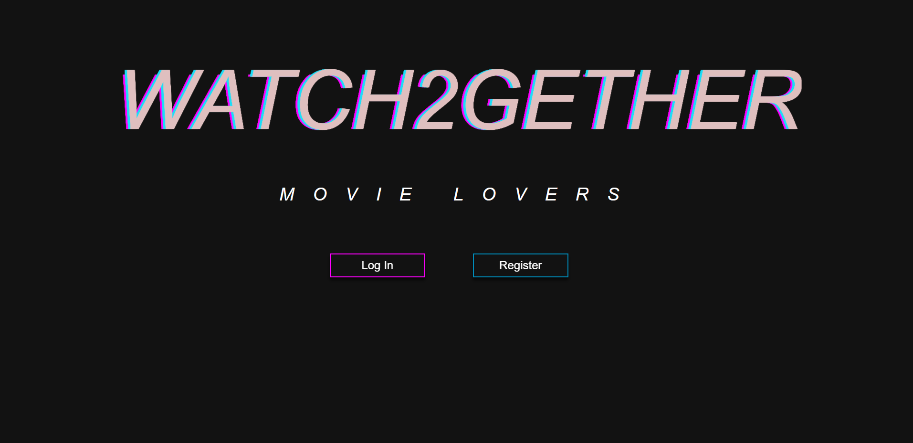
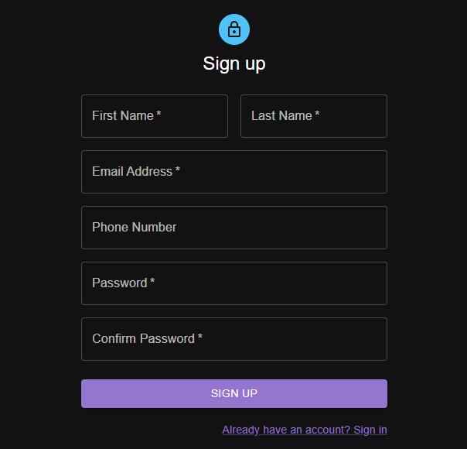
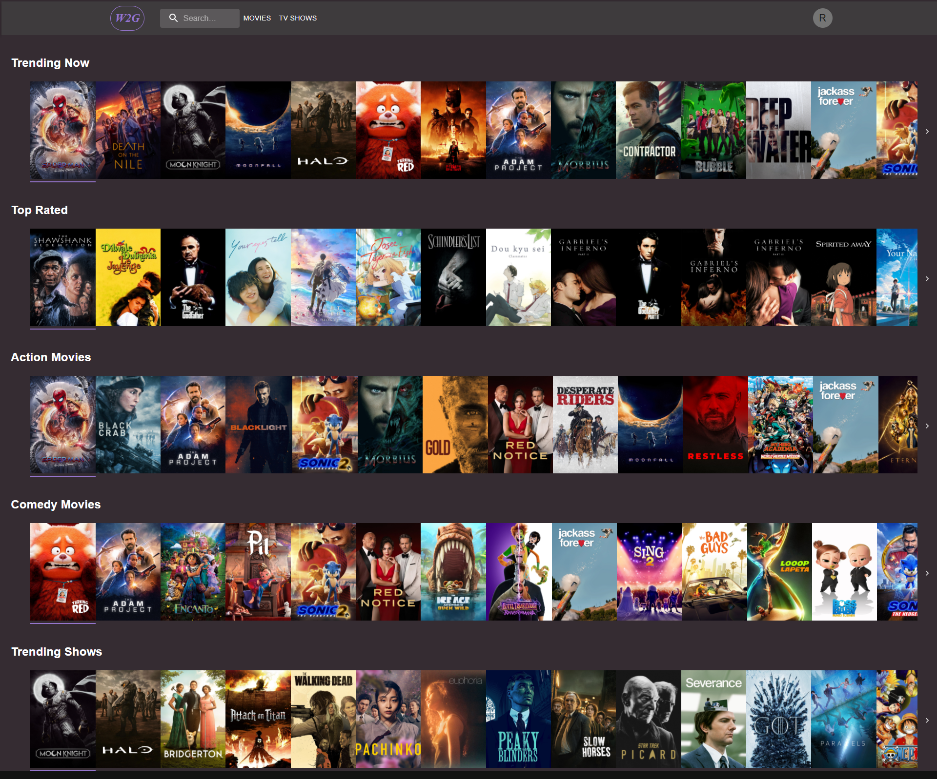
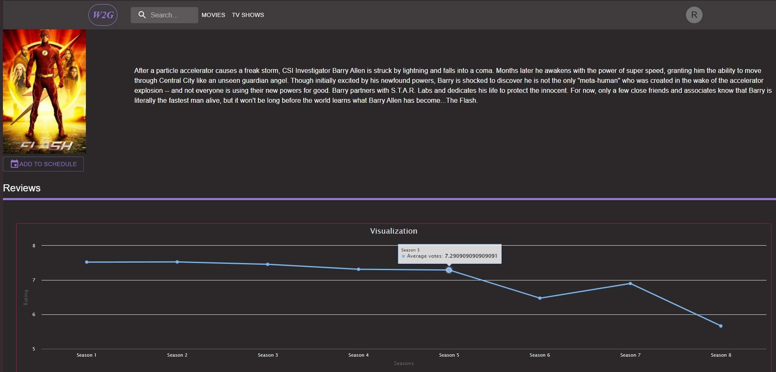
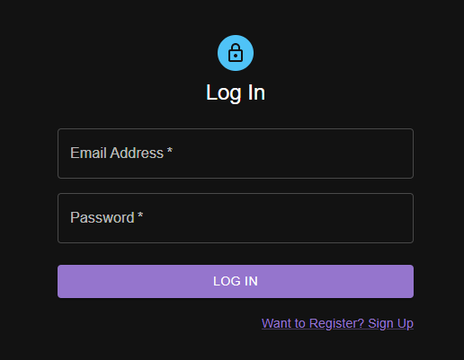
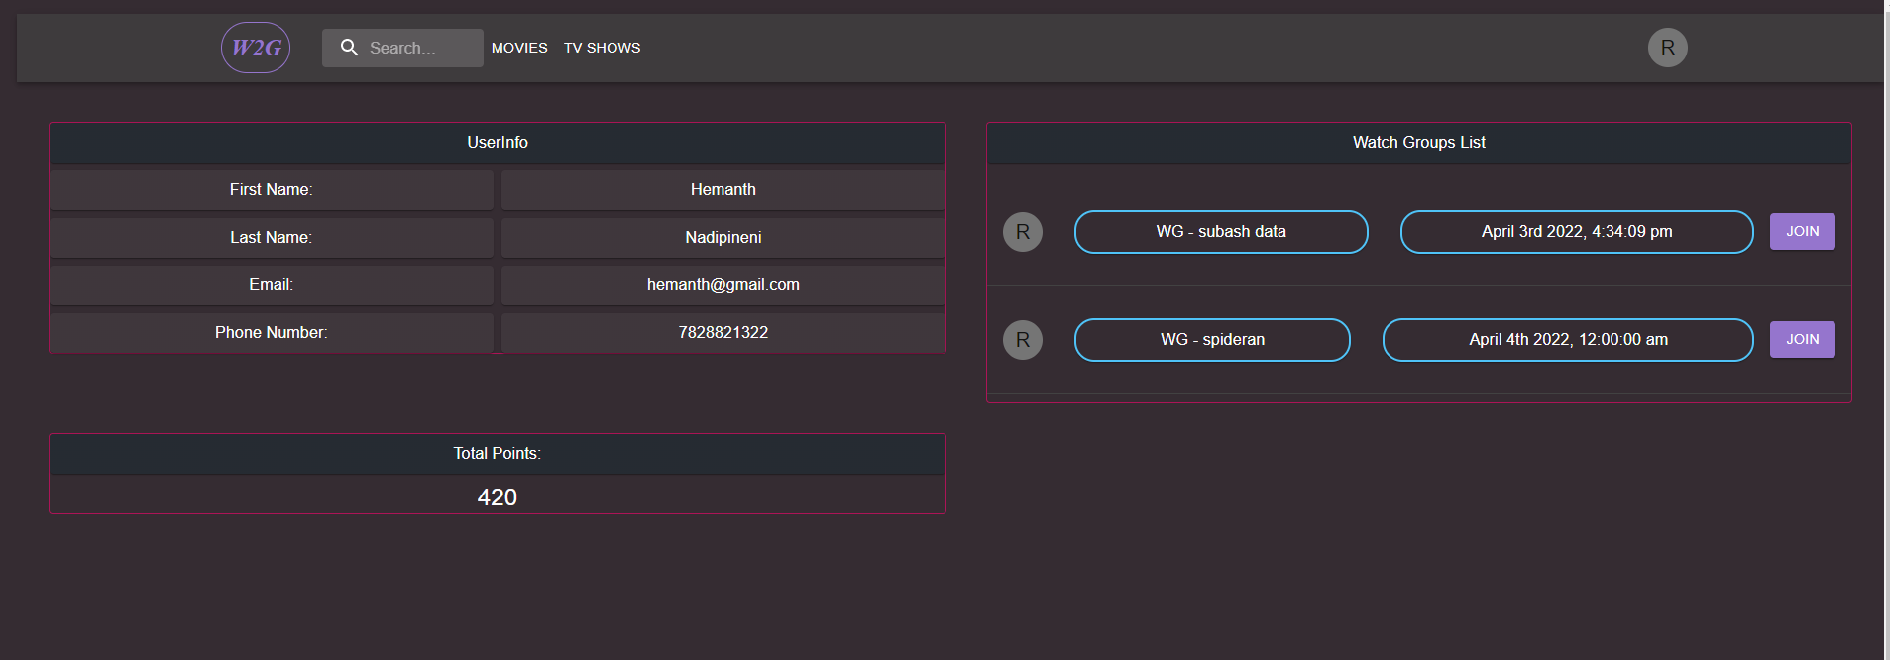
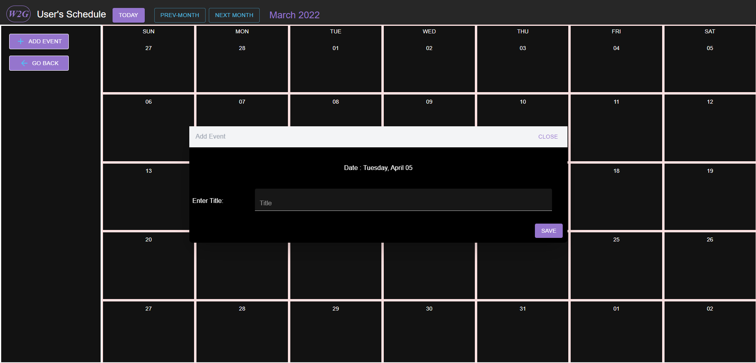
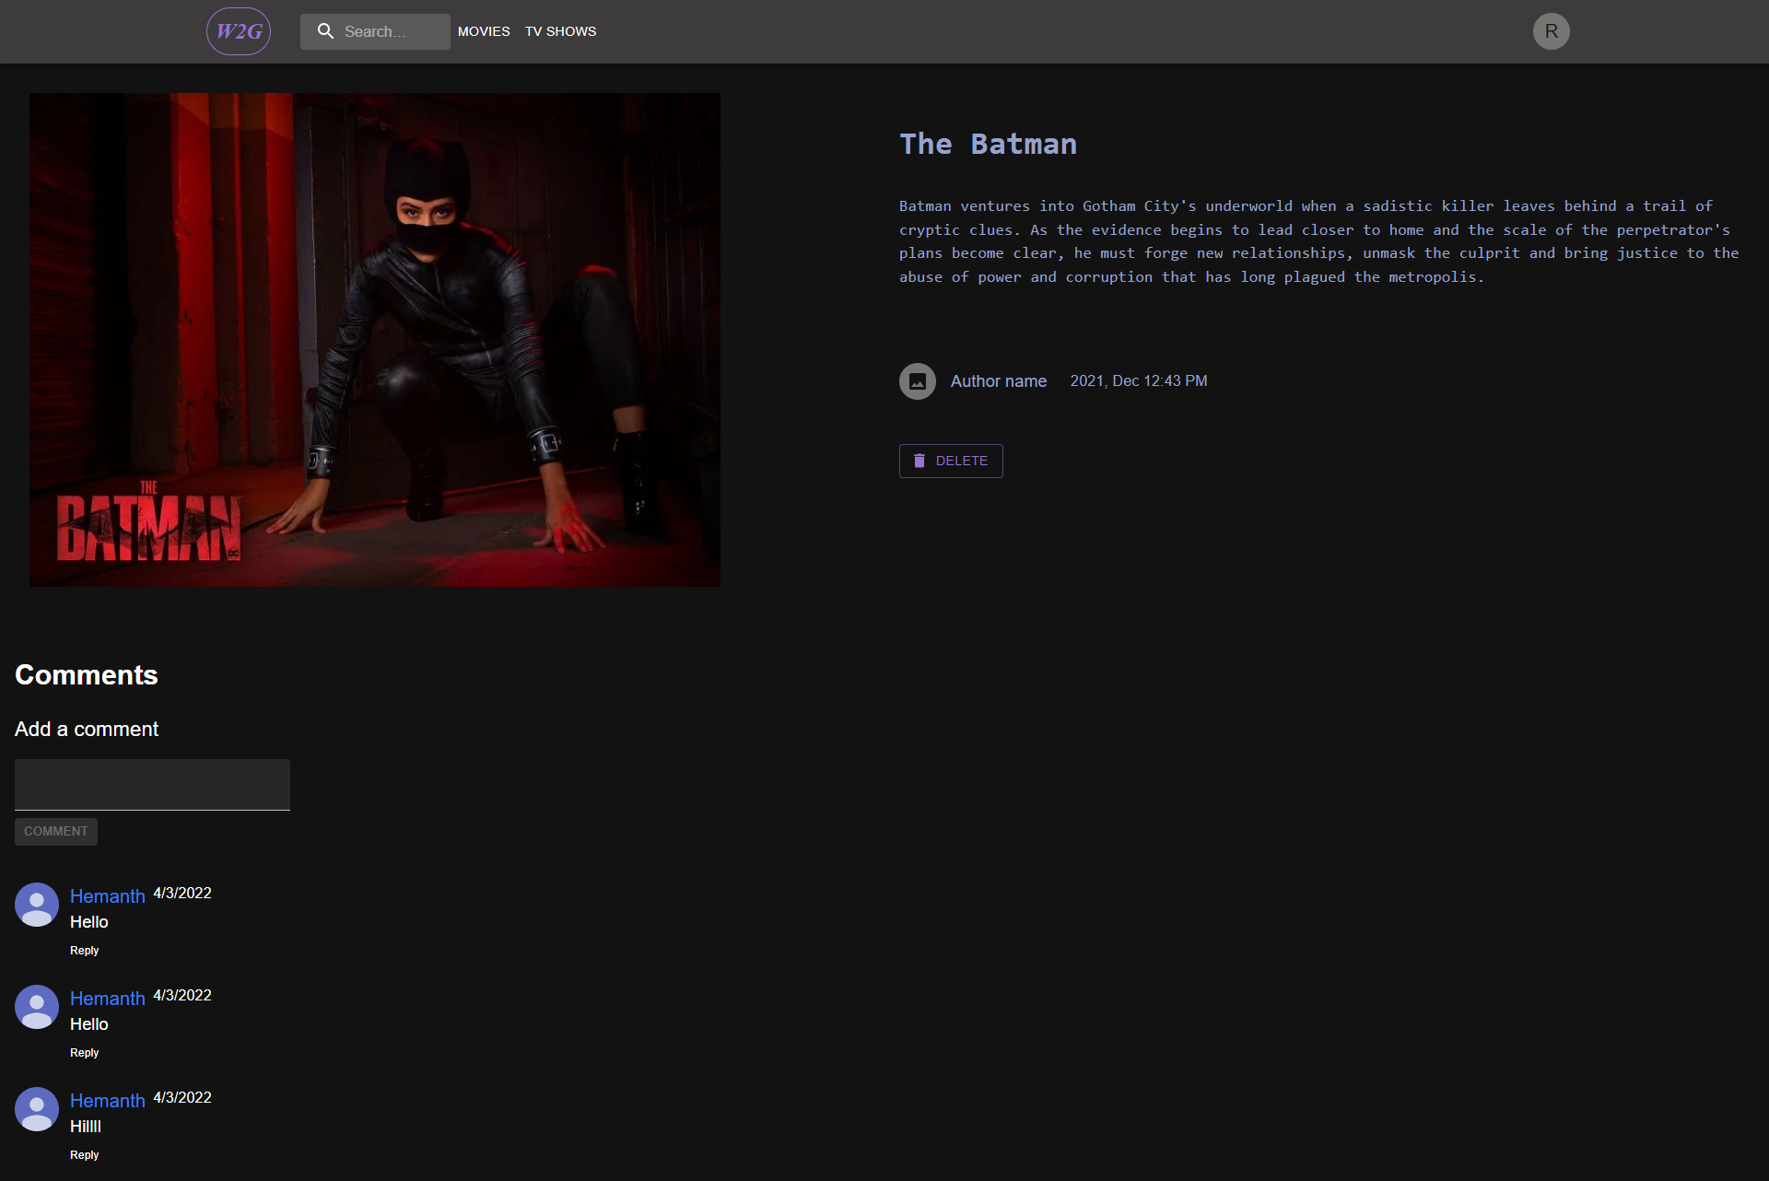
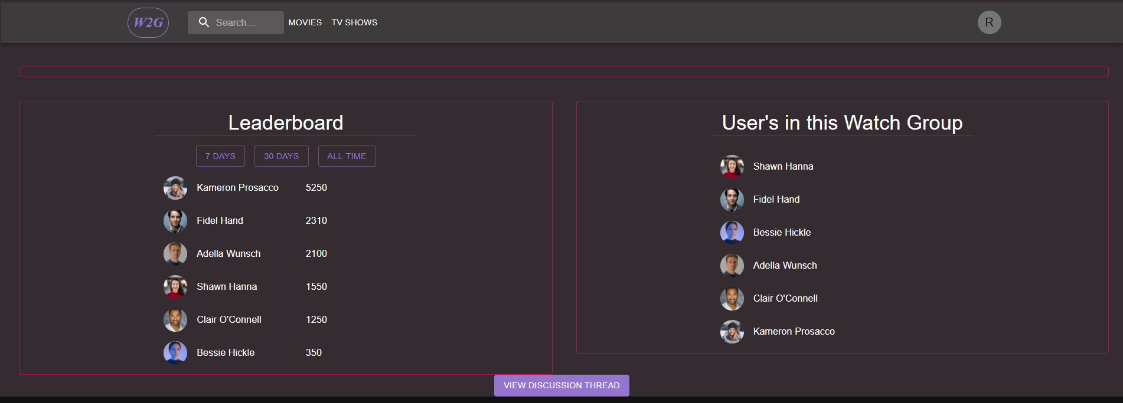
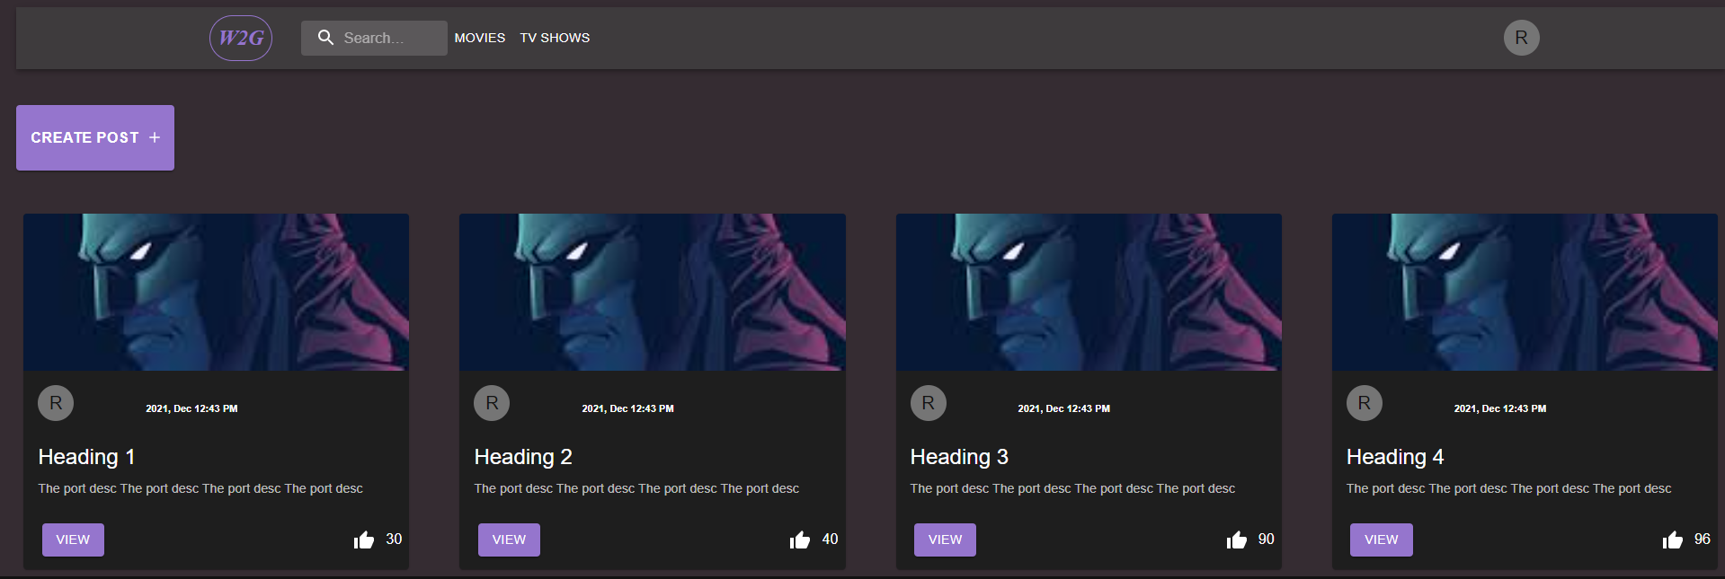
New users
Landing Page
Movie Page with Visualizer
Existing Users
Home Page
User Profile
Scheduler
Leader Board
Individual Post Page
Posts

Slide 11
Project Status w.r.t. Mid-Term Goals
Project Status w.r.t. Goals
Modules | Goals | Achieved or Not
General | CI/CD | Achieved
 | User Sign Up | Achieved
 | User Login | Achieved
 | Landing Page | Achieved
 | Heroku Deployment | Achieved
 | Home Page | Achieved
Visualizer | Movie Rating | Achieved
 | TV Show Rating Calculation | Achieved
 | Chart Plotting by generating data for y axis and x axis | Achieved
 | TV Show Rating - episode ratings for each season | Achieved
 | chart styling to match Application | Achieved
 | View the ratings of any show or movies | Achieved
 | legends and x-axis and y-axis labels for chart. | Achieved
 | hovering data points to display ratings | Achieved
 | Fetching from TMDB API to get shows/movies | Achieved

Slide 12
Project Status w.r.t. Goals
Modules | Goals | Achieved or Not
Scheduler | Create Calendar View | Achieved
 | Create Month Toggle buttons | Achieved
 | Add Event option | Achieved
 | Delete Event function | Achieved
 | Edit Event Function | Achieved
 | Update events in backend | Achieved
 | Fetch events from backend | Achieved
 | View Watch group from event | Achieved
 | Create Calendar View | Achieved
Watch Group | Creating watch Group based on user schedule | Achieved
 | Join watch Group when user selects a watch Group | Achieved
 | Join existing watch group based on users interest | Achieved
 | Total points received by user for his/her engaging posts | Achieved

Slide 13
Project Status w.r.t. Goals
Modules | Goals | Achieved or Not
Discussion Thread | Create Post Functionality | Achieved
 | Create Post Form | Achieved
 | List of existing Post | Achieved
 | View Post | Achieved
 | Upvote Post | Achieved
 | Allocate points to users based on likes | Achieved
 | Leaderboards for a particular watch group | Achieved
 | User belonging to a particular dashboards | Achieved
 | Filters based on weekly, monthly, All time. | Achieved
 | Add Comment Option | Achieved
 | Reply Comment | Achieved
 | Reply Sub Comment | Achieved
 | Delete Comment | Achieved
 | Sort Comments based on recency | Achieved
 | Edit Comment option | Achieved

Slide 14
LEARNING FROM THE PROJECT
Set up CI/CD as the first step to progress smoothly.
Utilizing Jira's advanced features for tracking tasks and ease of project management.
Implementing lazy loading to improve app performance.
More daily stand-up meeting to follow the agile process completely which also improves coordination and bring clarity to the remaining and upcoming task in the development.
Following a strict template and standards for merge requests.
Limited access to merging to avoid all conflicts and coordinate together before pushing the code.

